Slide 1
Senior Managing Diabetes -Group 10

Slide 2
Phase 1
1

Slide 3
introduction to problem space
Diabetes:
has several different forms, but all related to the body not produce enough insulin, or not responding to it.
insulin metabolizes glucose (sugar), so is critical to ensuring energy is available
Complications:
failing to manage diabetes can result in loss of limbs, loss of sight, and even premature death
Seniors:
are most commonly diagnosed with type 2 diabetes
are less apt to use sophisticated technologies to assist daily tasks
may have the least support to manage health issues
Quantified self:
smartphones are becoming commonly used to manage fitness, diet, and health
the diabetes health condition must also be carefully managed
1

Slide 4
Phase 2
2

Slide 5
user research
prepared interview script
planned to be the primary instrument
prepared questionnaire and observation plan
recruited relatives, friends, and friends of friends
2

Slide 6
Phase 3
3

Slide 7
user research
summary of research:
found that users had a broad range of experiences with diabetes
found out how users manage diabetes: what tools they use and how they do it
found a wide spectrum of attitudes towards computing technologies
3

Slide 8
user research
user needs:
learn how to use the tools and devices
learn how to interpret the device information
learn what decisions to make and when
learn how to balance diet, exercise, insulin dosing
develop and maintain healthy habits
receive encouragement and advice for healthy choices
3

Slide 9
targeted population
persona
decided to focus on seniors newly diagnosed with diabetes, as their needs are the most acute
key scenarios
users faced with unfamiliar situations and requiring guidance to make decisions about meals and exercise
3

Slide 10
Phase 4
4

Slide 11
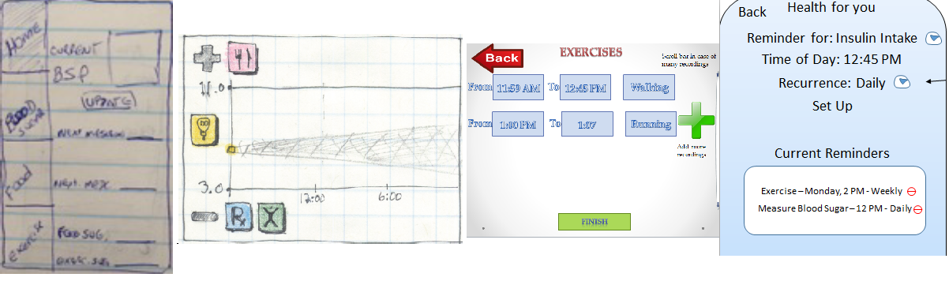
design summary
A4 individual design work
5 different designs for smartphone apps
4

Slide 12
design evaluations
Group analysis of individual designs
each design was reviewed by all group members
some consensus was reached about the best points of each design, and some common shortcomings
Picking the best ideas
brainstorming session followed to list all of the ideas that were generated
the creative brief was reviewed to reiterate the project objectives
a coherent set of ideas was selected to create the collective design
4

Slide 13
design decisions
Features
preloaded prescription information
preloaded meal and exercise suggestions
database for nutritional values
reminder/alert settings
manual data input
logging of historical data
scatter-plot for blood glucose data
4

Slide 14
design decisions
Interface
drop-down menus instead of scroll bars
central and persistent menu bar for navigation
pop-ups for settings
consistent page format for different data types
4

Slide 15
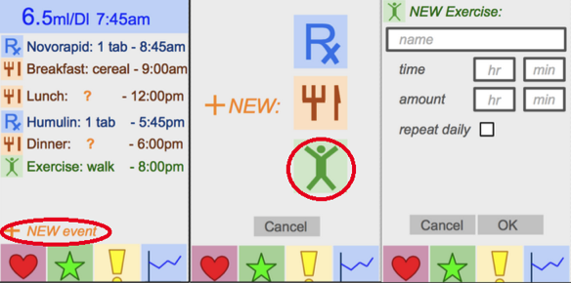
design mock-up
Adding an activity to the day’s events
4

Slide 16
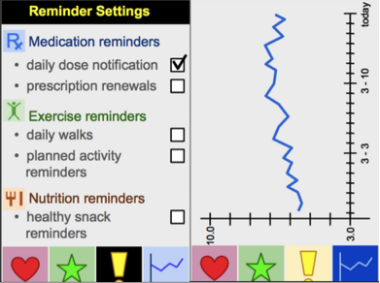
design mock-up
Viewing settings and historical blood glucose data
4

Slide 17
Phase 5
5

Slide 18
P4 prototype evaluation
Peer group prototype evaluations
mostly positive feedback
suggestion: main menu buttons need some explanation
suggestion: provide more evident feedback about meal and exercise choices
suggestion: provide prominent visual and auditory aids
suggestion: add an explanation for the graph
5

Slide 19
design decisions
Enhancements
provide clear indication of purpose of main menu buttons
relocate the ‘+ NEW EVENT’ button in the calendar view
reserve a space in the calendar view for advice, encouragement, assessment of the day’s plans for meals and exercise
provide accessibility features to compensate for visual impairments
5

Slide 20
our system’s advantages
our system will
provide centralized access to blood-glucose current data and history
have an expert system for predicting short-term blood-glucose levels and use this for providing advice on healthy choices
provide a database of healthy meal options
present a straightforward interface to the user
anticipate user needs to reduce the need for user input
provide reminders for scheduled insulin doses
5

